Slide 1
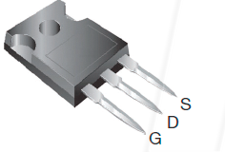
MOSFET’s
(metal–oxide–semiconductor field-effect transistor)

Slide 2
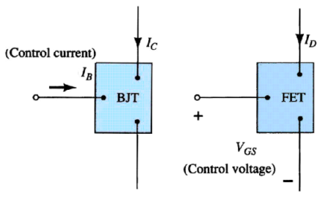
Current Controlled vs Voltage Controlled Devices

Slide 3
FET ( Field Effect Transistor)
Few important advantages of FET over conventional Transistors
Unipolar device i. e. operation depends on only one type of charge carriers (h or e)
Voltage controlled Device (gate voltage controls drain current)
Very high input impedance (≈10⁹-10¹² Ω)
Low Voltage Low Current Operation is possible (Low-power consumption)
Less Noisy as Compared to BJT
Very small in size, occupies very small space in Ics
Low voltage low current operation is possible in MOSFETS

Slide 4
Types of Field Effect Transistors
(The Classification)
        JFET
MOSFET (IGFET)
n-Channel JFET
p-Channel JFET
FET
Enhancement MOSFET
Depletion MOSFET
n-Channel EMOSFET
p-Channel EMOSFET
n-Channel DMOSFET
p-Channel DMOSFET

Slide 5
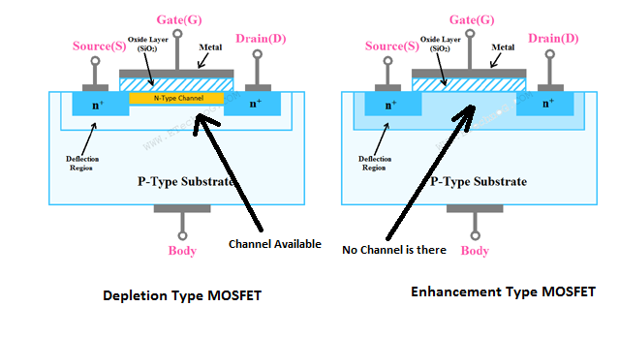
MOSFETs
MOSFETs have characteristics similar to JFETs and additional characteristics that make them very useful.
There are 2 types of MOSFET’s:
Depletion mode MOSFET (D-MOSFET)
Enhancement Mode MOSFET (E-MOSFET)

Slide 6
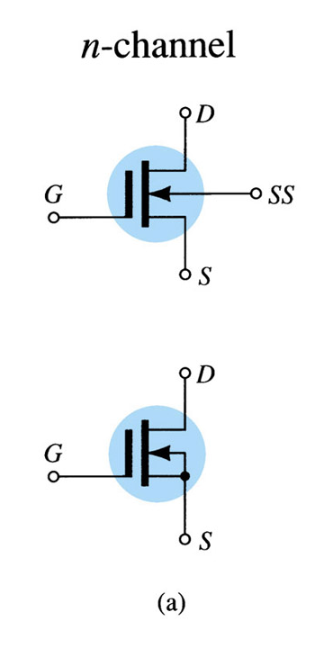
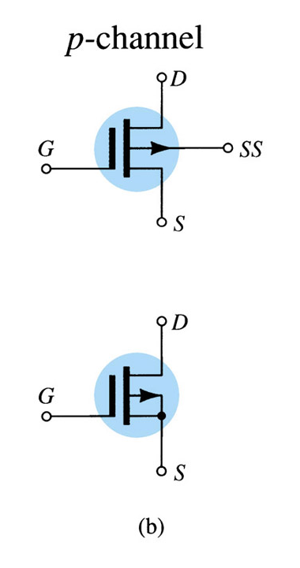
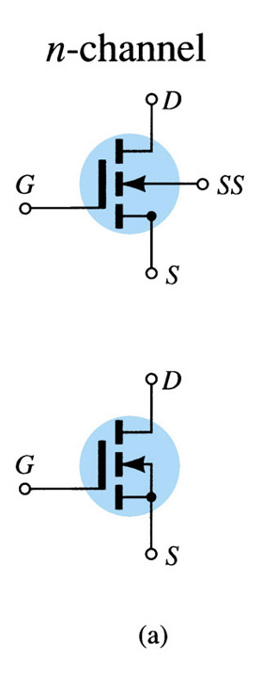
D-MOSFET Symbols
E-MOSFET Symbols

Slide 7
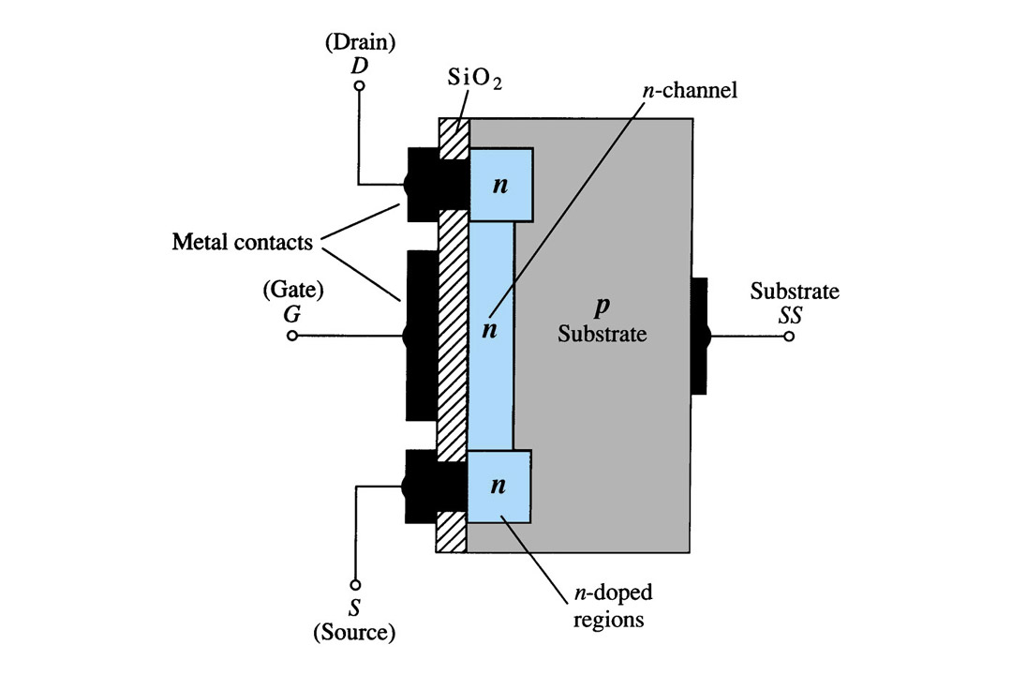
Depletion Mode MOSFET Construction
The Drain (D) and Source (S) leads connect to the to n-doped regions
These N-doped regions are connected via an n-channel
This n-channel is connected to the Gate (G) via a thin insulating layer of SiO₂
The n-doped material lies on a p-doped substrate that may have an additional terminal connection called SS

Slide 8
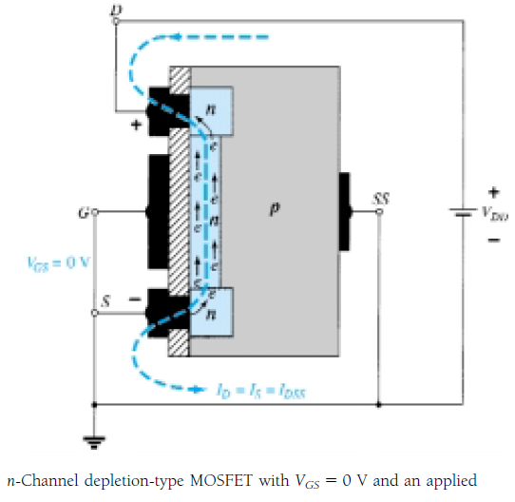
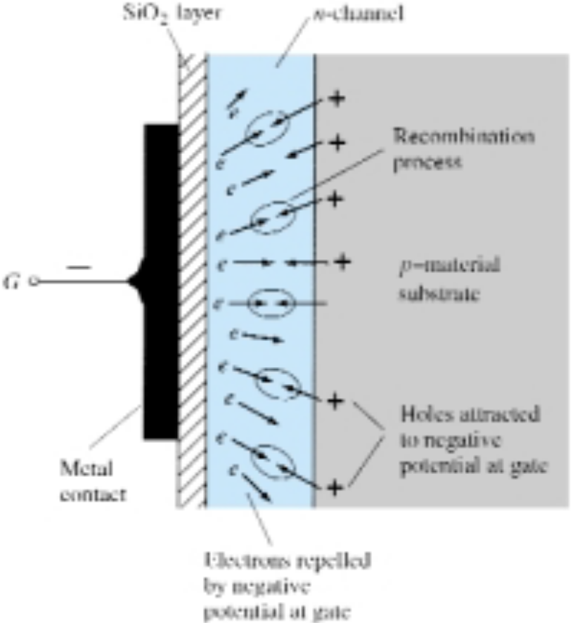
Basics Operation

Slide 9
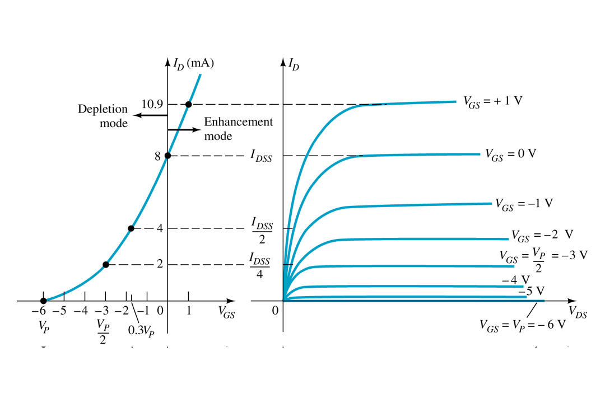
Basic Operation
A D-MOSFET may be biased to operate in two modes:
the Depletion mode or the Enhancement mode

Slide 10
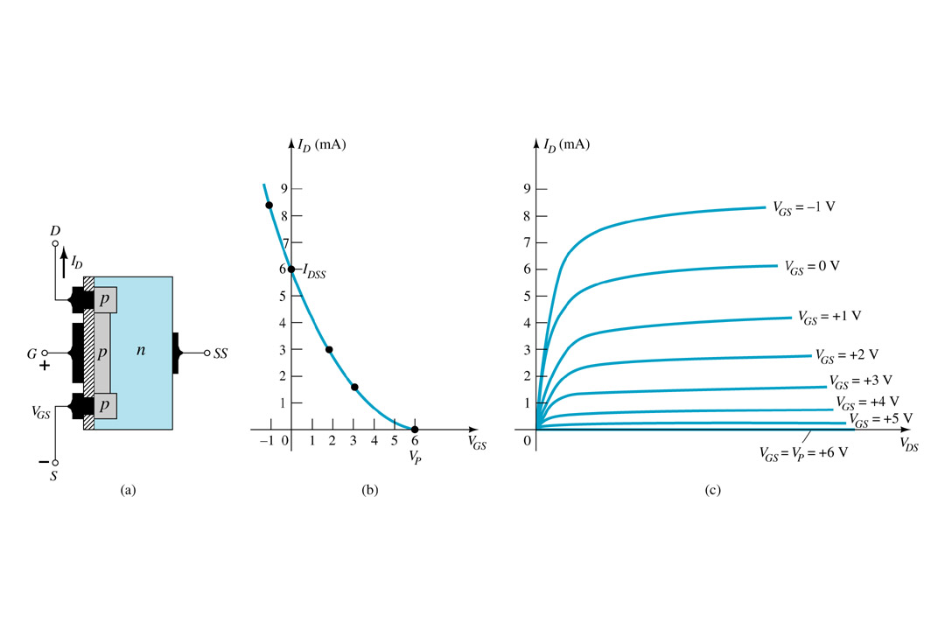
p-Channel Depletion Mode MOSFET
The p-channel Depletion mode MOSFET is similar to the n-channel except that the voltage polarities and current directions are reversed

Slide 11
Enhancement Mode
MOSFET’s

Slide 12
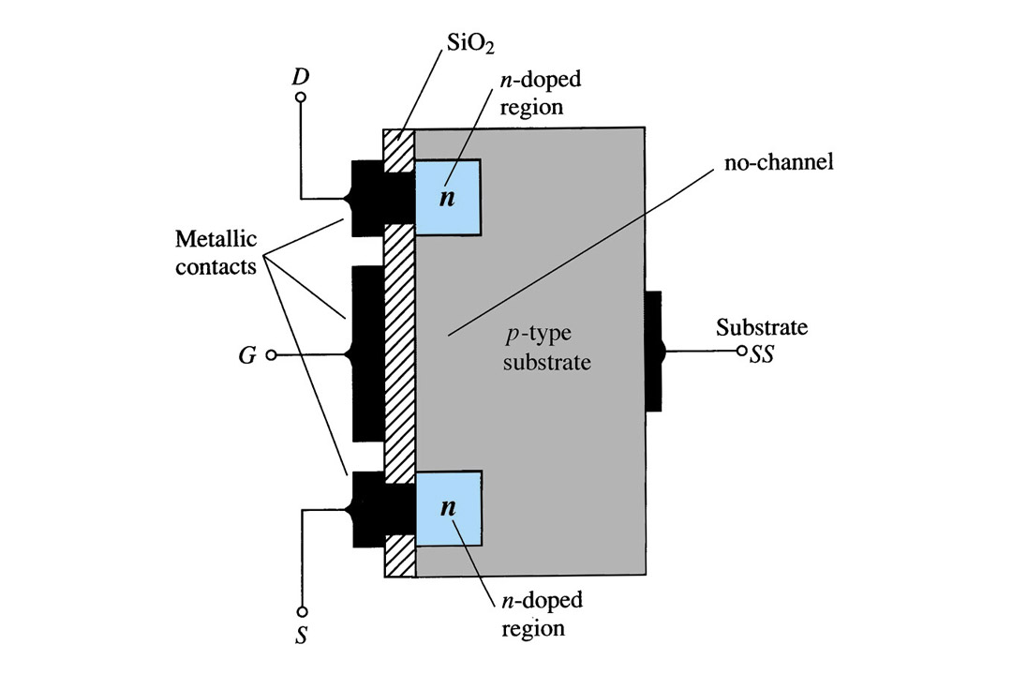
Enhancement Mode MOSFET Construction
The Drain (D) and Source (S) connect to the to n-doped regions
These n-doped regions are not connected via an n-channel without an external voltage
The Gate (G) connects to the p-doped substrate via a thin insulating layer of SiO₂
The n-doped material lies on a p-doped substrate that may have an additional terminal connection called SS

Slide 13
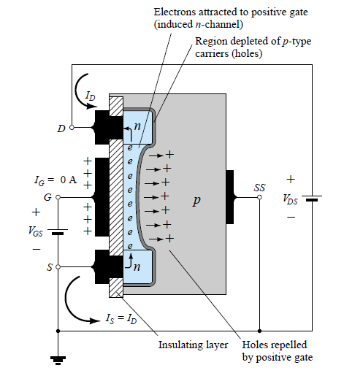
Basics opeartion

Slide 14
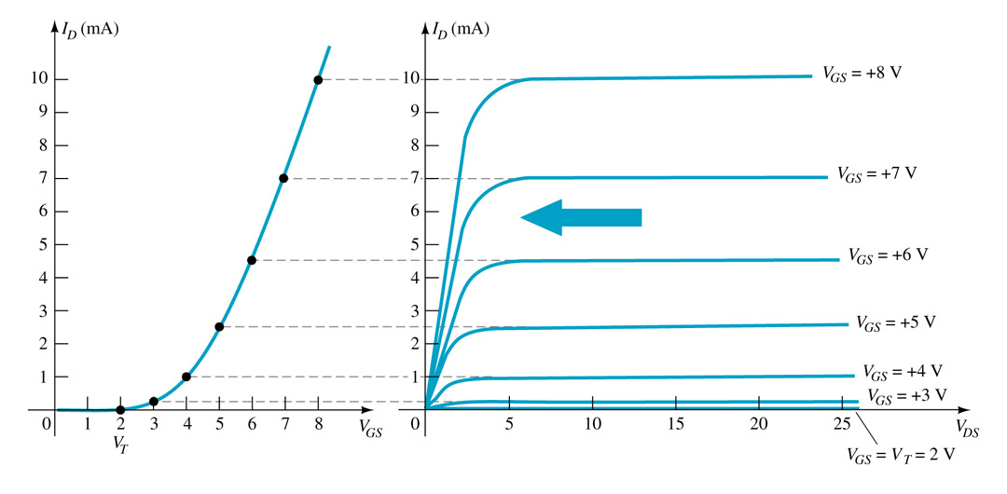
Basic Operation
The Enhancement mode MOSFET only operates in the enhancement mode.
VGS is always positive
IDSS = 0 when VGS < VT
As VGS increases above VT, ID increases
If VGS is kept constant and VDS is increased, then ID saturates (IDSS)
The saturation level, VDSsat is reached.

Slide 15
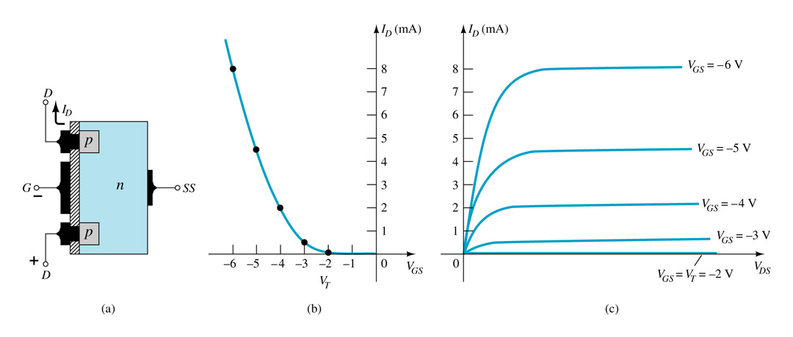
p-Channel Enhancement Mode MOSFETs
The p-channel Enhancement mode MOSFET is similar to the n-channel except that the voltage polarities and current directions are reversed.

Slide 16
MCQ
A JFET has three terminals, namely …………
(A) cathode, anode, grid
(B) emitter, base, collector
(C) source, gate, drain
(D) none of the above

Slide 17
MCQ
A MOSFET is a ………… driven device
(A) current
(B) voltage
(C) both current and voltage
(D) none of the above

Slide 18
MCQ
A MOSFET can be operated with ……………..
(A) negative gate voltage only
(B) positive gate voltage only
(C) positive as well as negative gate voltage
(C) none of the above

Slide 19
MCQ
The input control parameter of a MOSFET is ……………
(A) gate voltage
(B) source voltage
(c) drain voltage
(D) gate current

Slide 20
MCQ
The input impedance of a MOSFET is of the order of ………..
(A) 1 Ω
(B) a few hundred Ω
(C) kΩ
(D) several MΩ

